Slide 1
A Study on the Confrontation Plan
of Trade Education In Universities
reflected on the 4th Industrial Revolution
Yunjin Oh

Slide 2
The department of commerce and Trade’s Countermeasures
for the 4th Industrial Revolution
Ⅰ. Introduction
Ⅱ. The 4th Industrial Revolution Technology and the Change in the Trade Environment
1. The Fourth Industrial Revolution Technology
2. Change in the Trade Environment
Ⅲ. Countermeasures for The 4th Industrial Revolution and Education on Trade
1. Changes in the Department of Trade in Korea (based on university education)
2. Countermeasures for Trade Education Reflecting The Fourth Industrial Revolution
Ⅳ. In Conclusion

Slide 3
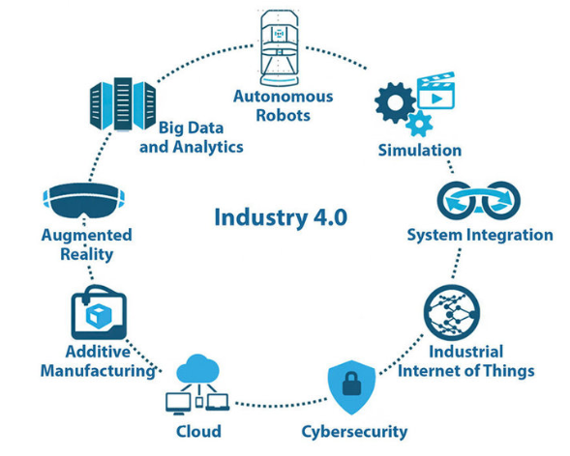
Ⅰ. Introduction
The Fourth Industrial Revolution Technology
The new technologies are making an improvement in services that were previously under time and space limitations
also causing the environment of trade to change at a quick rate

Slide 4
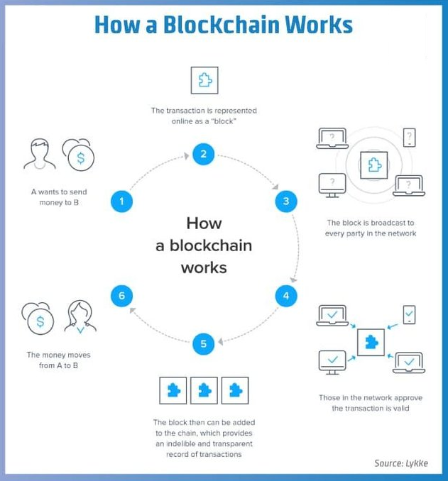
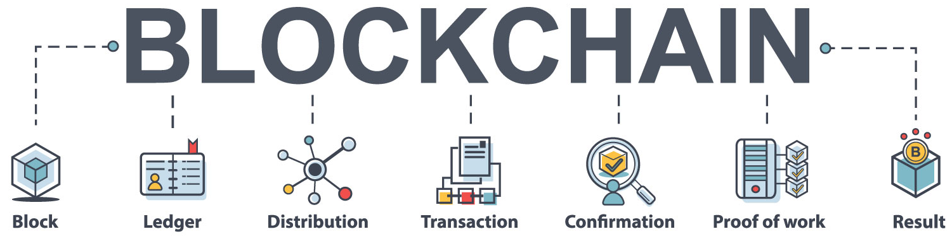
Ⅱ. The 4th Industrial Revolution and the Change in the Trade Environment
1. The 4th Industrial Revolution Technology
Block Chain Technology
A blockchain is a form of technology that stores digital information, and each block contains a database of a participant’s digital data such as their transaction records
In the order of issuance, it uses hash value to connect a previous block to one that follows after. Then, it uses all or a partial of its participants’ information in a P2P manner to distribute and manage the database stored on their computer

Slide 5
Ⅱ. The 4th Industrial Revolution and the Change in the Trade Environment
1. The 4th Industrial Revolution Technology
AI(Artificial intelligence) Technique
Artificial intelligence (AI) is intelligence demonstrated by machines, as opposed to natural intelligence displayed by animals including humans
Leading AI textbooks define the field as the study of "intelligent agents": any system that perceives its environment and takes actions that maximize its chance of achieving its goals
Some popular accounts use the term "artificial intelligence" to describe machines that mimic "cognitive" functions that humans associate with the human mind, such as "learning" and "problem solving", however, this definition is rejected by major AI researchers

Slide 6
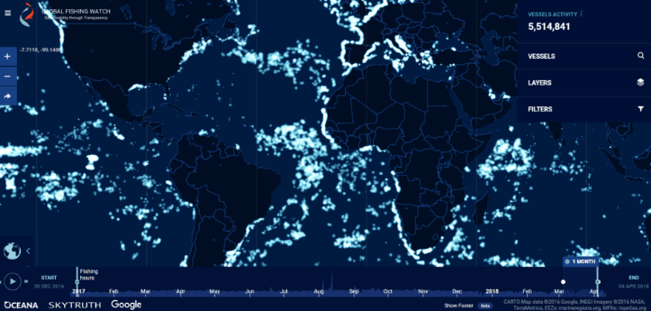
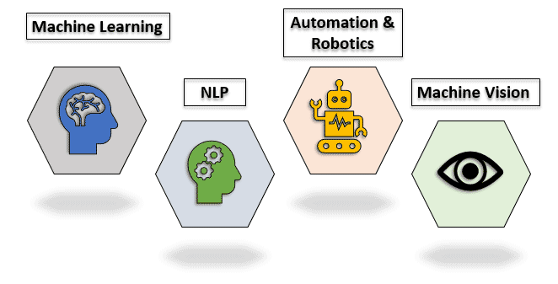
Ⅱ. The 4th Industrial Revolution and the Change in the Trade Environment
1. The 4th Industrial Revolution Technology
AI(Artificial intelligence) Technique
[Figure] Google's Global Fishing Watch [Figure] Techniques of AI

Slide 7
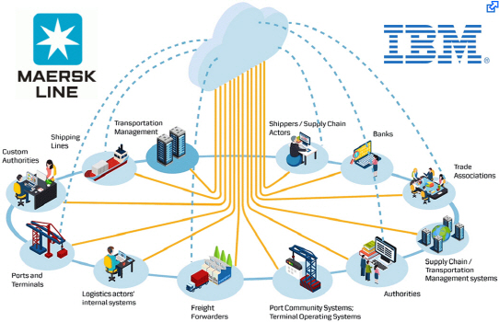
Ⅱ. The 4th Industrial Revolution and the Change in the Trade Environment
2. Change in the Trade Environment
[Figure] Tradelens between IBM and MERSK
Tradelens solution to help manage and track goods and the paper trail of millions of shipping containers by digitizing the supply chain process to enhance transparency and
the highly secure sharing of information among partners – shippers, freight forwarders, ocean carriers, customs authorities, and ports.
The solution, which is expected to be a has the potential to save the global economy billions of dollars

Slide 8
Ⅱ. The 4th Industrial Revolution and the Change in the Trade Environment
2. Change in the Trade Environment
When combined with other advanced technologies, such as the internet of things (IoT) and artificial intelligence, blockchain unfold their full potential
Smart contracts and e-wallets
- Paperless and high speed
- Putting documents on the blockchain brings significant advantages
- Maersk has been participating in a proof of concept, with blockchain expertise from the IT
University of Copenhagen, to digitize the bill of lading
- Eliminating piles of papers speeds up processing and reduces costs and risks

Slide 9
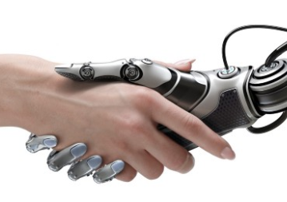
Change in the Department of Trade course in Korea
Ⅲ. Countermeasures for The 4th Industrial Revolution and Education on Trade
Changes in the Department of Trade in Korea - Based on university education -
[Table] Change in the Department of Trade course in Korea
1960
1970 ∼1980
1990 ∼2000
In the future
Economics
Business administration
Trade practice
Trade English
Trade finance
HS commodity
(harmonized commodity description and coding system)
Etc.
1960 Course +
international capital movement theory
international economic organization theory
economic integration theory economic cooperation theory
Etc.
1960~1980 Course +
E-Trade such as e-commerce
Cyber trade theory
E-business theory
Determining the country of origin related to the FTA
Etc.
The goal was to cultivate talented people familiar with trade practice
The curriculum of trade studies expanded their range of Economic education
Information education related to international trade had strengthened
Notes:
https://medium.com/regenerative-global/education-and-the-fourth-industrial-revolution-cd6bcd7256a3

Slide 10

Change in the Department of Trade course in Korea
Ⅲ. Countermeasures for The 4th Industrial Revolution and Education on Trade
2. Countermeasures for Trade Education Reflecting The 4th Industrial Revolution
To reflect the link between and the related contents of the "STEM"
subject in regard to trade education reflecting the fourth industrial revolution
A. The Etymology of STEM
In the 1990s, the National Science Foundation (NSF) called it SMET as an abbreviation of “Science, Mathematics, Engineering, and Technology
B. The Purpose of STEM
The fourth industrial revolution needs to cultivate creative convergence people with the ability to create new values and solve complicated problems in order to be able to face the era of uncertainty.
Notes:
https://teach.com/careers/become-a-teacher/what-can-i-teach/stem/
http://www.stemedcoalition.org/

Slide 11

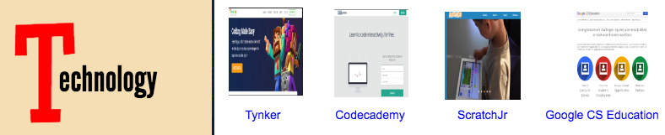


Ⅲ. Countermeasures for The 4th Industrial Revolution and Education on Trade
Change in the Department of Trade course in Korea
2. Countermeasures for Trade Education Reflecting The 4th Industrial Revolution
C. STEM Education in the United States
STEM Education in the United States
STEM education is being conducted through various ways in schools all around the United States
Textbooks and programs on STEM education are being actively developed in universities, research institutes, or even non-profit organizations with the support from the state
The Subject and Target of STEM Education
At the elementary and secondary level, it focuses on science and mathematics, which is the basis of science and engineering
Applies integrated STEM education to all grades or flexibly improves existing programs
Notes:
https://teach.com/careers/become-a-teacher/what-can-i-teach/stem/

Slide 12
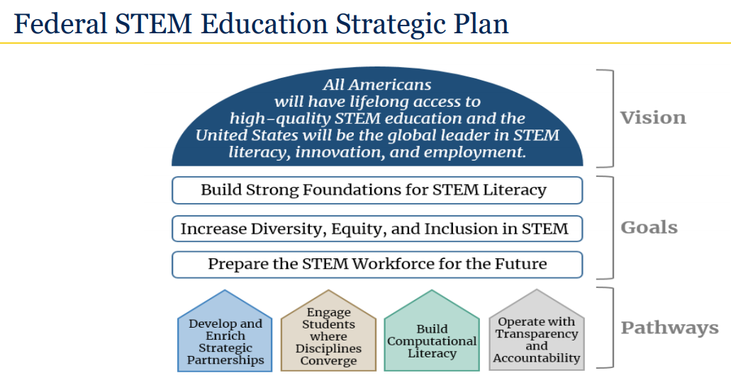
Ⅲ. Countermeasures for The 4th Industrial Revolution and Education on Trade
Change in the Department of Trade course in Korea
2. Countermeasures for Trade Education Reflecting The 4th Industrial Revolution
C. STEM Education in the United States
Source.: Federal STEM Education Strategic Plan: 2 Years Later, November 2020

Slide 13
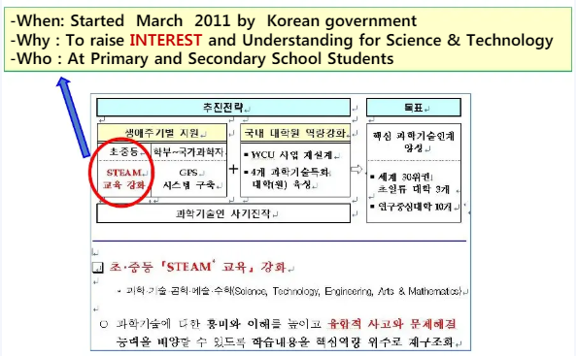
Ⅲ. Countermeasures for The 4th Industrial Revolution and Education on Trade
Change in the Department of Trade course in Korea
2. Countermeasures for Trade Education Reflecting The 4th Industrial Revolution
D. STEM Education in the Korea
Change in the Department of Trade course in Korea

Slide 14
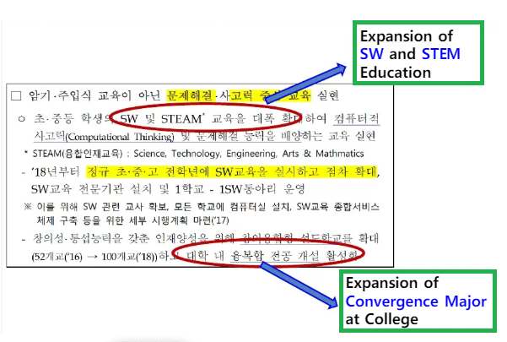
Ⅲ. Countermeasures for The 4th Industrial Revolution and Education on Trade
Change in the Department of Trade course in Korea
2. Countermeasures for Trade Education Reflecting The 4th Industrial Revolution
D. STEM Education in the Korea
Change in the Department of Trade course in Korea

Slide 15
V. In Conclusion
The international trade in particular, with the development of the 4th industry, will have a different transaction pattern from the previously existing trade method
Therefore, it is judged that trade education should be a study that is grafted on the technologies of the 4th industrial revolution

Slide 16

Thank you!
hmoh@origin.or.kr

